Slide 1
EXPLOITATION & PREDICTION OF COMPANY REGISTRATION WITH REGISTER OF COMPANIES(ROC)
PRESENTED BY
M.PRIYADHARSHINI
212921106057

Slide 2
CONTENT :
Introduction
The Register of Companies (ROC)
Significance of analyse ROC trends
Data Collection
Data processing
Result
Conclusion

Slide 3
INTRODUCTION:
The analysis of company registration trends is a crucial task for various stakeholders, including government agencies, investors, and business researchers.
By understanding the patterns and fluctuations in company registration , one can gain valuable insights into the economic landscape, industry dynamics, and entrepreneurial activity within a region or country.

Slide 4
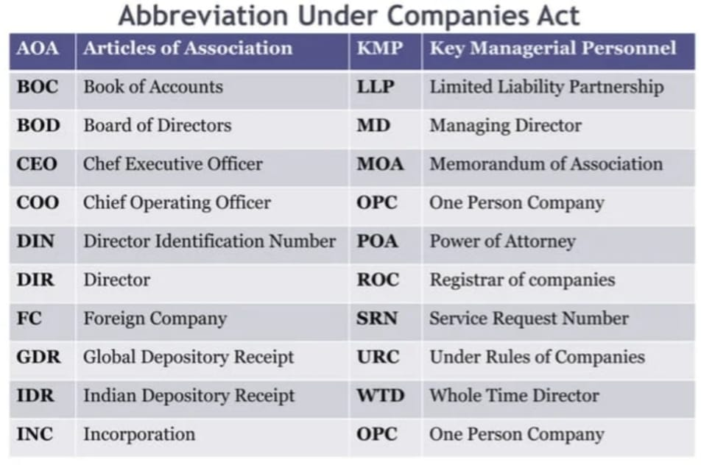

Slide 5
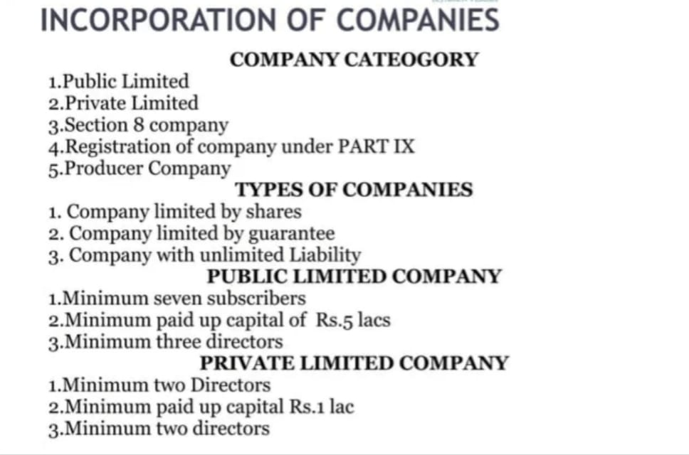

Slide 6
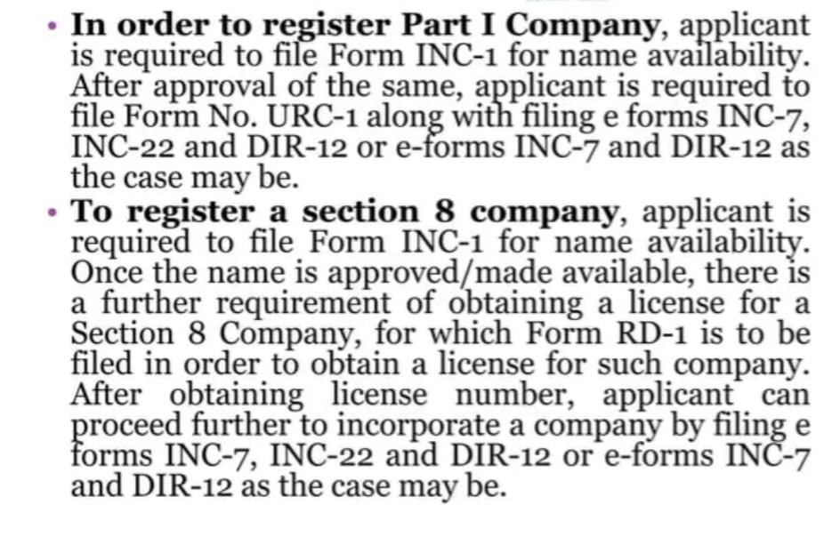

Slide 7
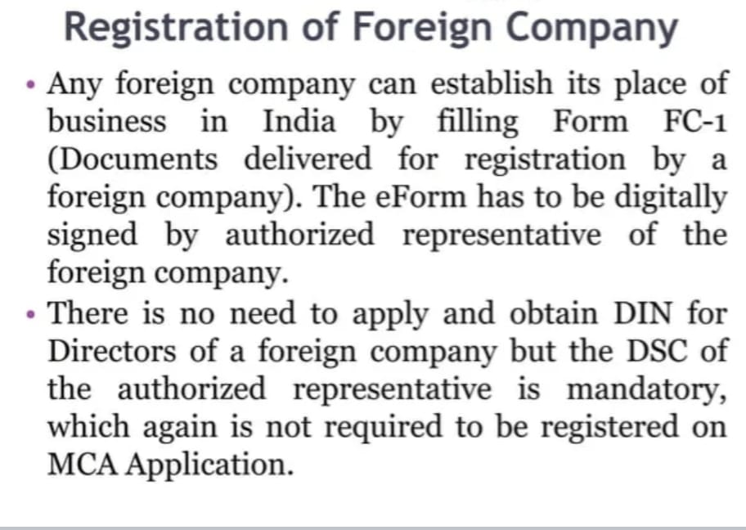

Slide 8
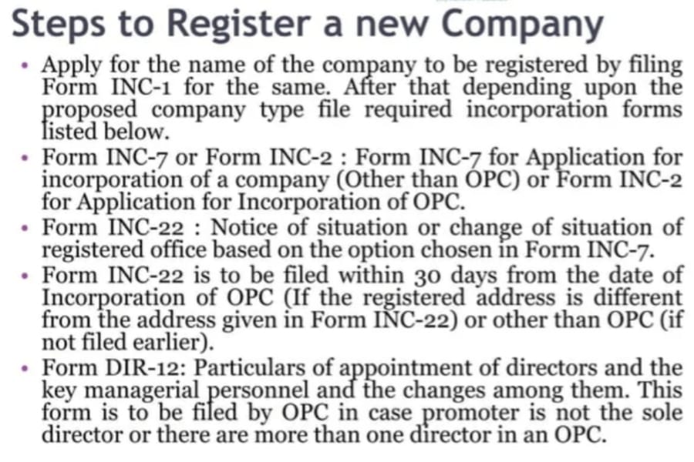

Slide 9
THE REGISTER OF COMPANIES(ROC)
The Register of Companies serves as a comprehensive database of all registered businesses and corporations within a jurisdiction.
This repository contains a wealth of information, including company names, registration dates, ownership details, and financial records.
Leveraging this data can facilitate the exploitation and prediction of company registration trends, which can inform policymaking, investment decisions, and market strategies.

Slide 10
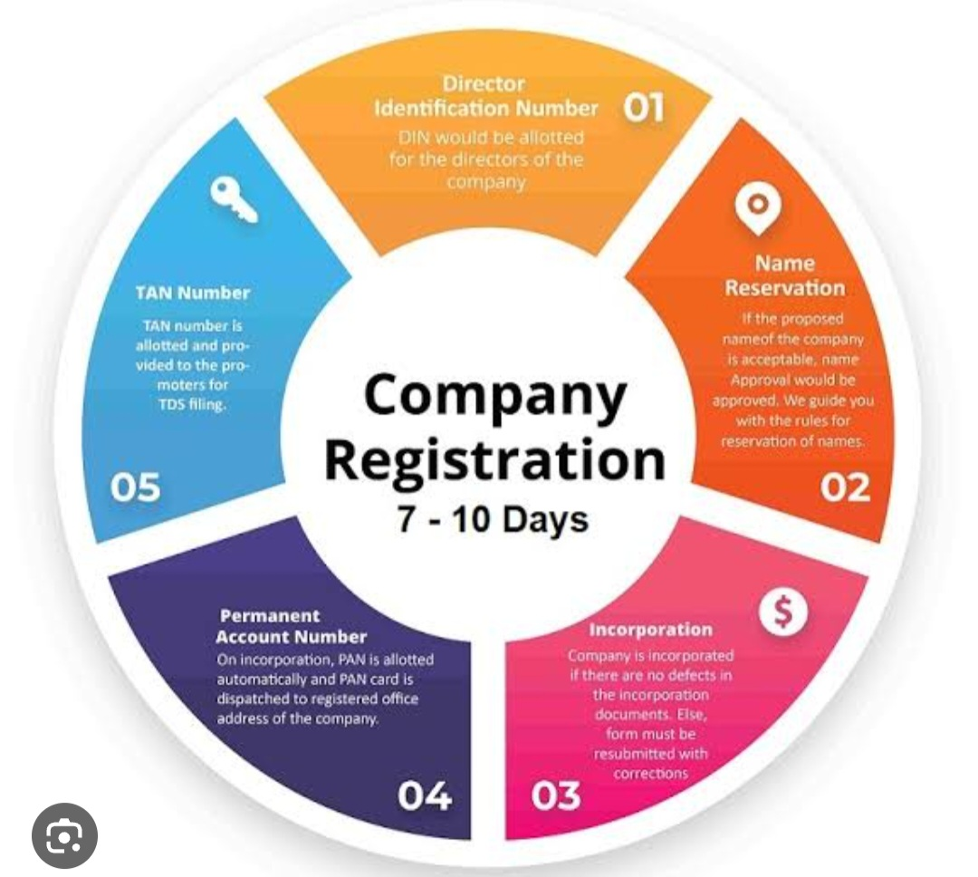

Slide 11
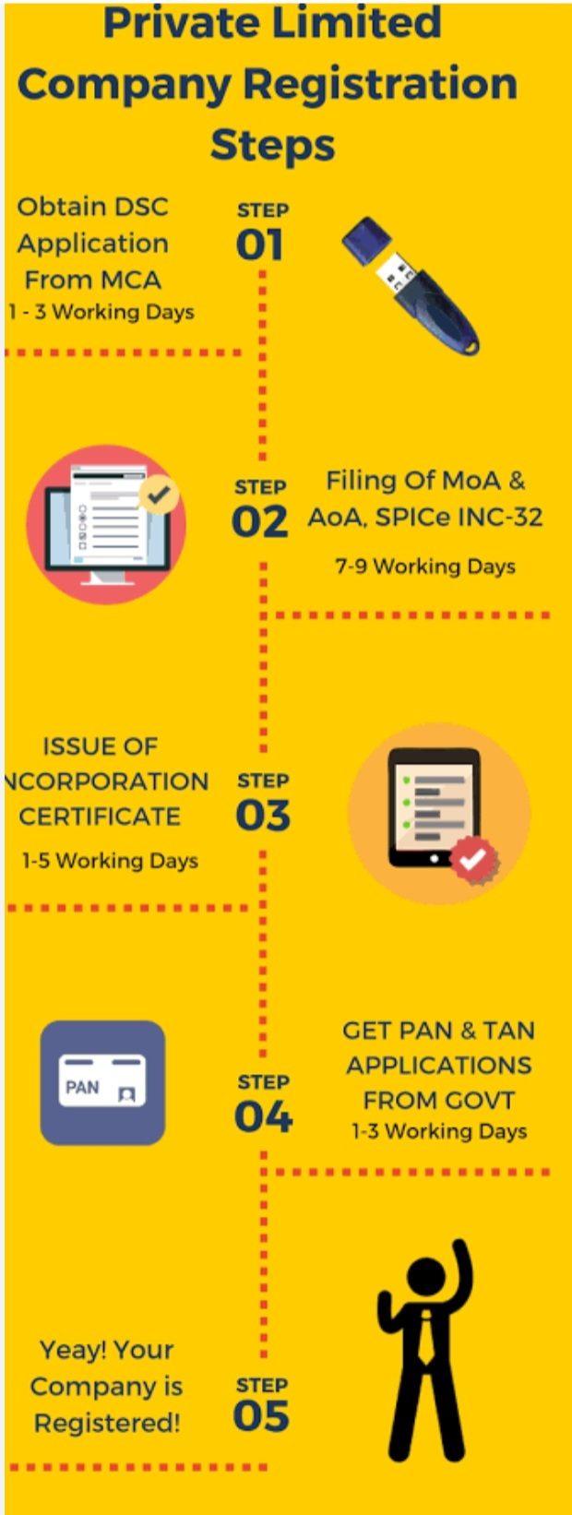

Slide 12
REQUIREMENT FOR REGISTRATION
REQUIREMENT FOR REGISTRATION
1. Filing of MOA, AOA, copy of agreement if any entered for appointment of MD or WTD and declaration in Form1with ROC (Sec.33)
2.Filing of form32
(Before filing mandatory DIN has to be obtained section266)
3. Filing of Form 18
4.Filing of Power of Attorney
5.Certified copy of Board resolution in case a company is the subscriber.

Slide 13
MOA REQUIREMENT
MOA REQUIREMENT
1. Name Clause: Name with the word 'Limited' for limited company and 'Private Limited' for private limited company.
2. Registered Office Clause: State in which Registered office is situated
3. Object Clause: Objects of the Company
i). Main objects
ii). Incidental objects
iii) Other objects 4.Liability clause
i). Company limited by shares or by guarantee should state that members liability is limited.
ii). Company limited by guarantee should state specifically the members liability in case of winding up.

Slide 14
MOA REQUIREMENT
5. Capital clause
Company having share capital, the capital should be stated with division unless it is an unlimited company no subscriber shall take less than one share Each
subscriber should write opposite to their name the no of shares subscribed.
6.Form of MOA should be in Table B, C, D and E of Schedule I (Sec.14)
Printing and signing of MOA (Sec.15)
7.MOA Should be printed
8.MOA Should be divided into paragraph and consecutively numbered
9.MOA Should be signed by the subscriber by adding his name, address and occupation witnessed by at least one witness.

Slide 15
AOA REQUIREMENT
AOA REQUIREMENT
1.Private Company limited by shares Conditions specified in sec. 3(i)(iii)(a), (b), (c) and (d) to be specified.
2.In case of company liability by guarantee, No of members should be mentioned. (Sec.27)
3. In case of unlimited company, the no of members and the company having share capital, the amount of share capital to be mentioned.(Sec.27)
4. Adoption of Table A (for company limited by shares) and Table C,D and E are optional. (Sec.28)
Regulations of AOA should not be inconsistent with any provisions of the Companies Act.

Slide 16
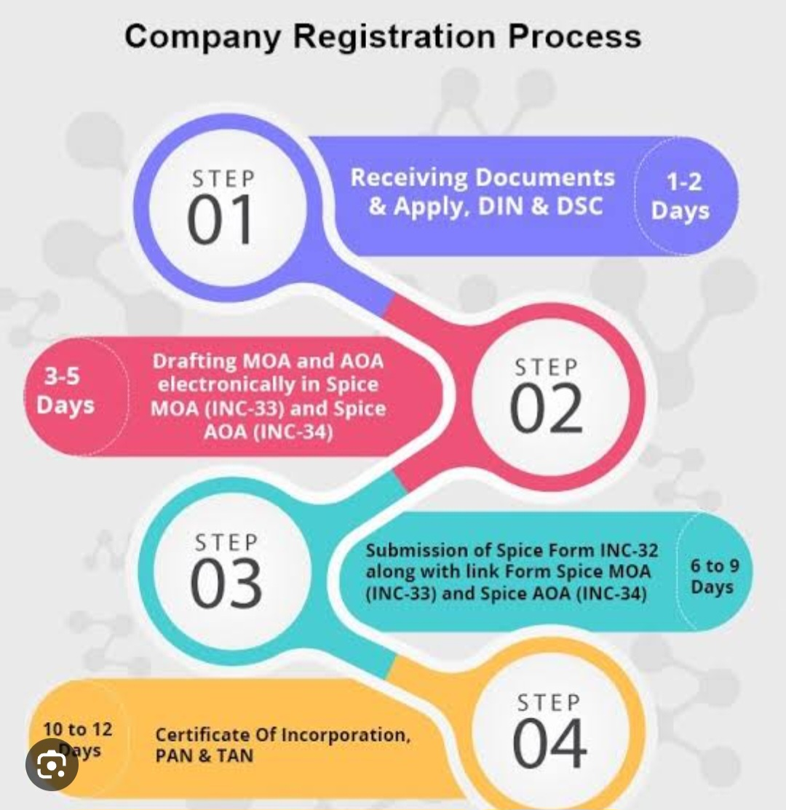

Slide 17
REGISTRATION OF PRODUCER COMPANY
REGISTRATION OF PRODUCER COMPANY
1. producer company with 10 or more persons 2. Main objects specified in section 581B 3.Liability of members limited by shares.
4.On registration, becomes a body corporate as if a private company
5. Producer company under any circumstance become or deemed to become a public limited company.

Slide 18
Producer company
MOA Requirement.
1. Name of the company with word â€œProducer Company
Limitedâ€
2, State in which Regd. Office situated
3. Main objects as per sec.581B
4. Name and address of subscribers
5. Share capital and its division

Slide 19
6. Name and address of subscribers who shall act as first
directors
7. Liability of members limited
8. No of shares subscribed written opposite to each
subscriber, not less than one share each.
9. If objects not confined to one state, the state to whose
territories the objects extend should be mentioned

Slide 20
SECTION AND COMPANY
SECTION 8 COMPANY Sâ€”
+ Company Object is for promoting commerce, art, science, religion,
charity or any other useful object and intends to apply profits in
promoting its objects and prohibit payment of dividend.
Â« The Central Government (Authority Regional Director) may by
Licence register with limited liability without addition of the wordâ€™
Limitedâ€™ or â€˜Private Limitedâ€™

Slide 21
Procedure:
+ 1.Name approval
+ 2.Draft MOA and AOA to be approved by Regional Director
Â« 3. Approval of Licence by Regional Director
Â« 4. Filing of Form1,Form32 and 18 along with approved MOA, AOA
and Licence copy to be filed with Registrar.

Slide 22
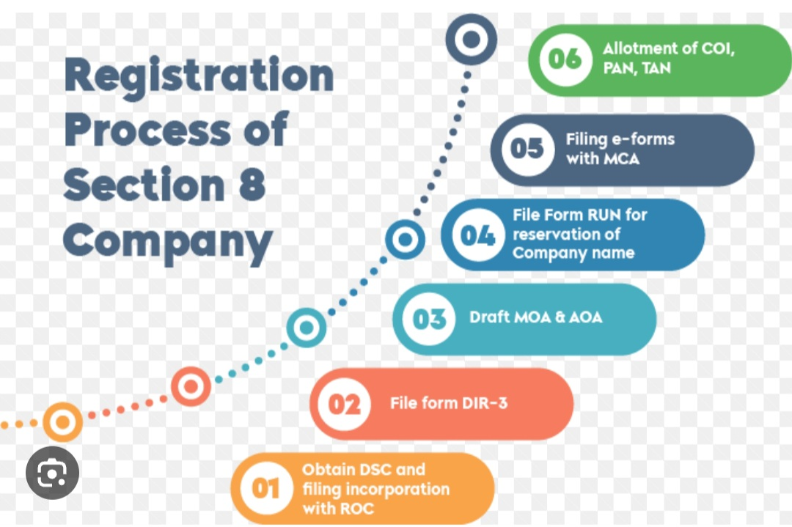

Slide 23
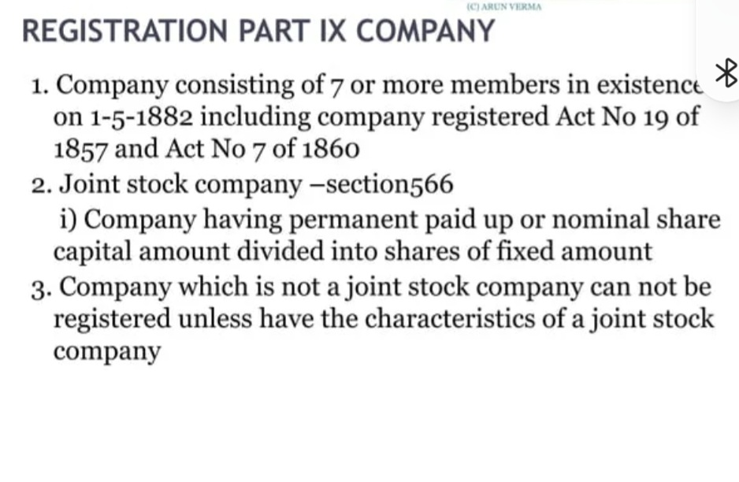

Slide 24
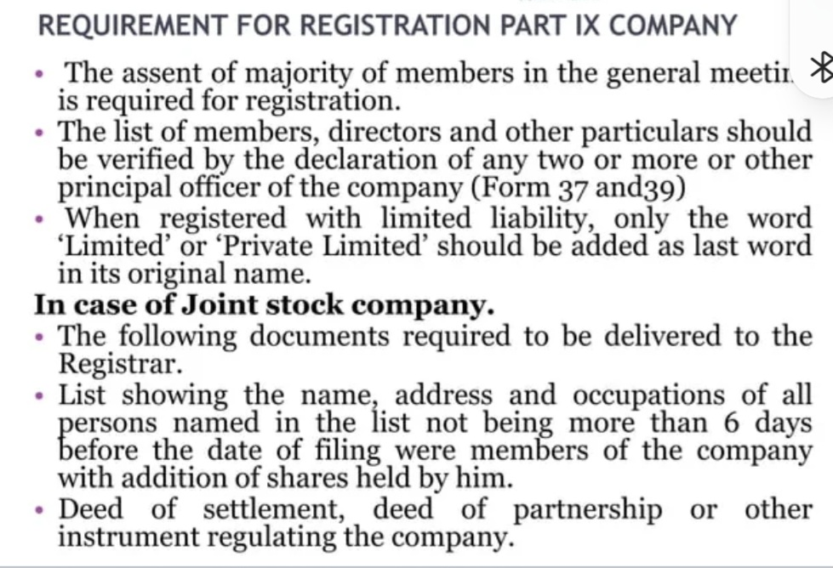

Slide 25
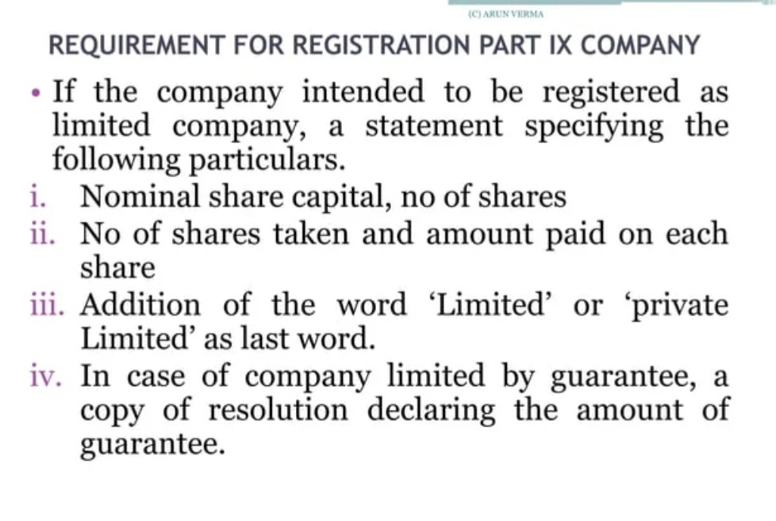

Slide 26
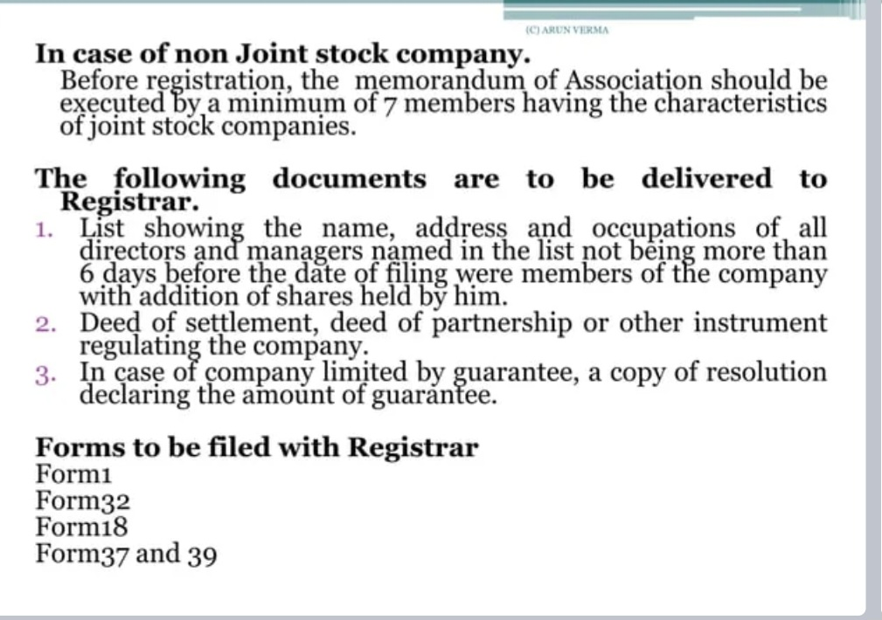

Slide 27
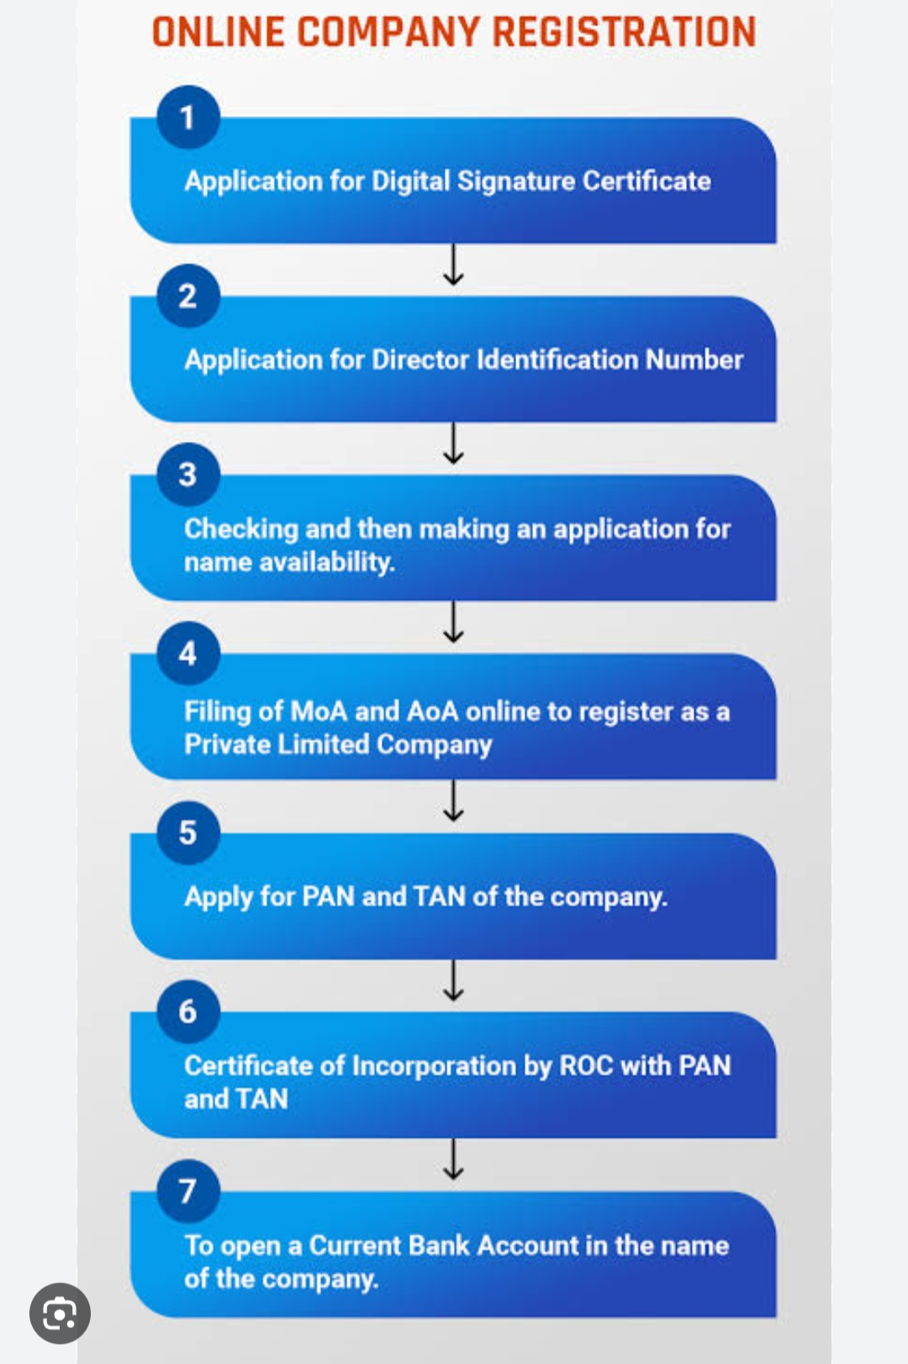

Slide 28
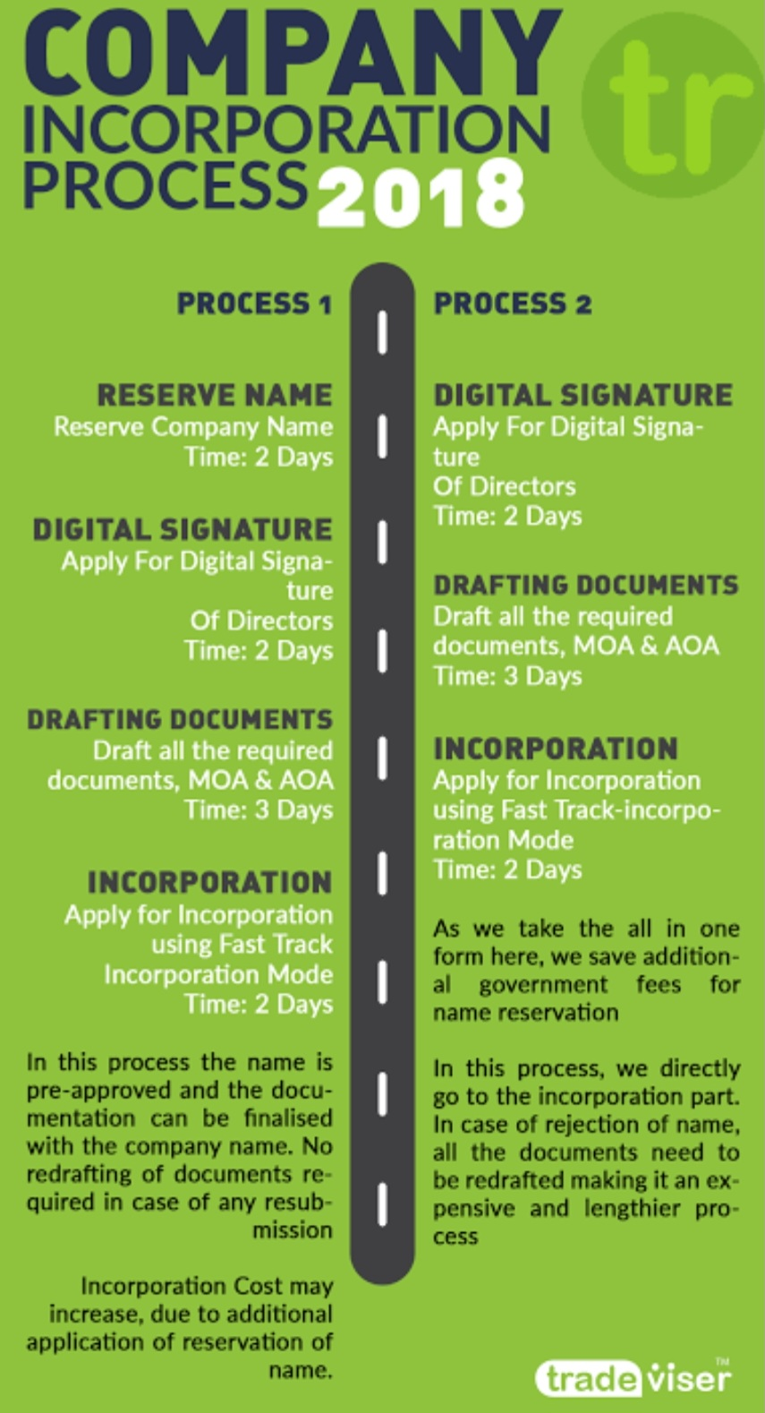

Slide 29
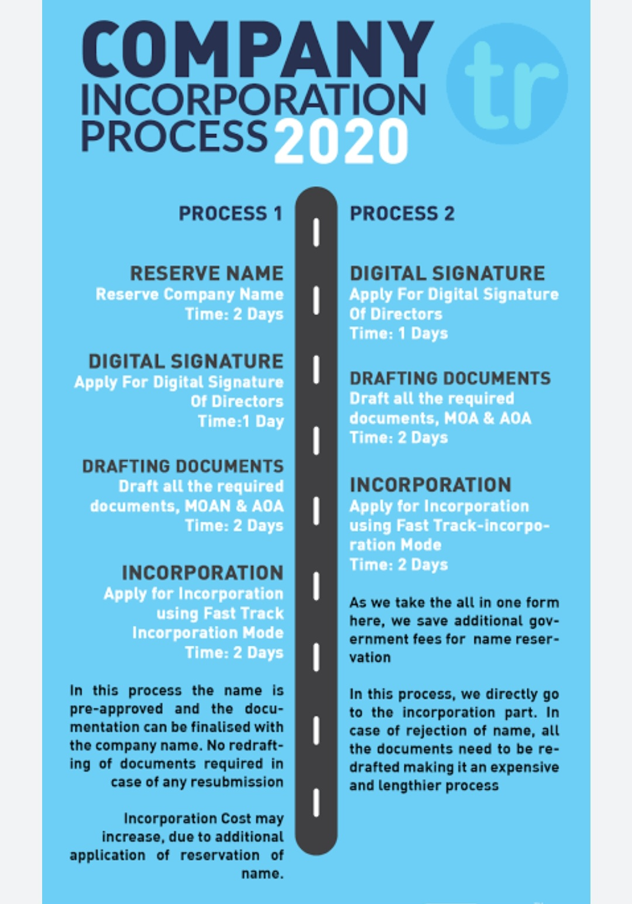

Slide 30
SIGNIFICANCE OF ANALYZE ROC TRENDS:
Economic health
Entrepreneurial Activity
Investment opportunities
Policy formulation
Market Research
Risk Assessment
Regional development
Job creation
Competition advantage

Slide 31
DATA COLLECTION:
To define objective and variable
data exploitation
data manipulation

Slide 32
DATA PROCESSING:
Data cleaning
Data transformation
Feature engineering
Time series analysis
Data normalization/ scaling
Data splitting
Data exploration

Slide 33
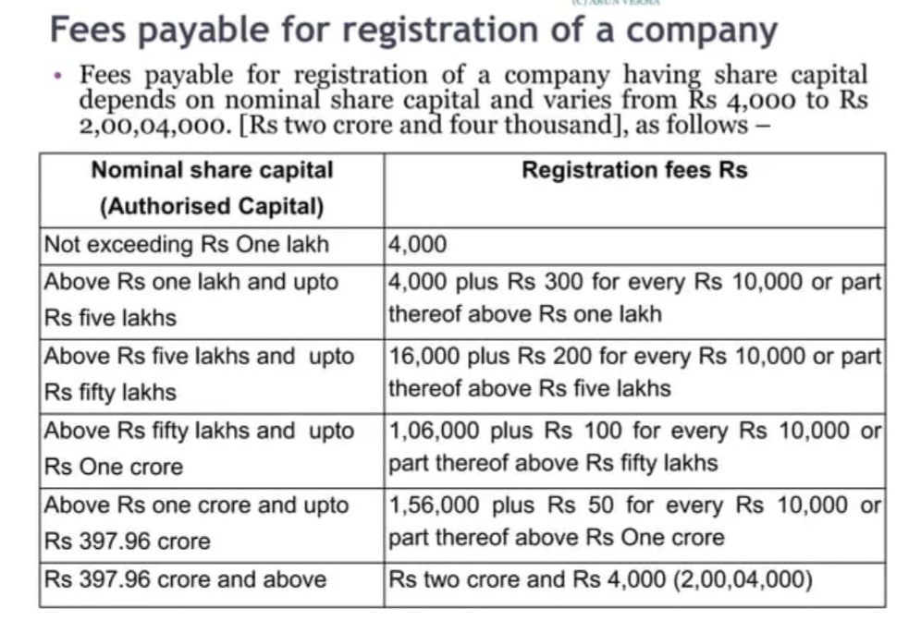

Slide 34
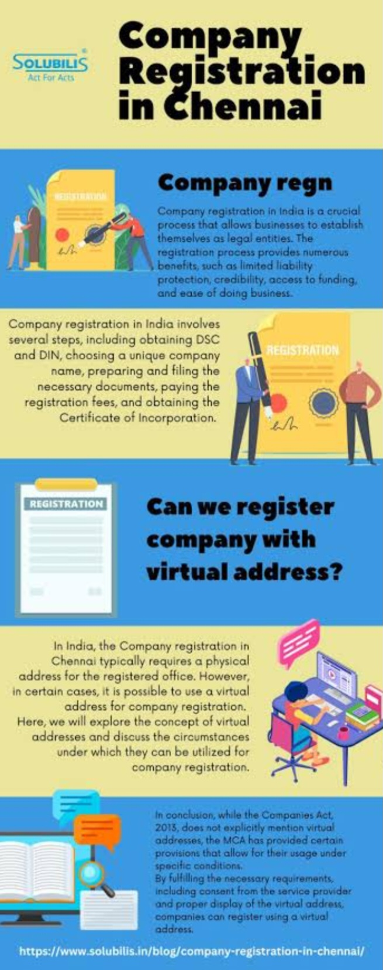

Slide 35
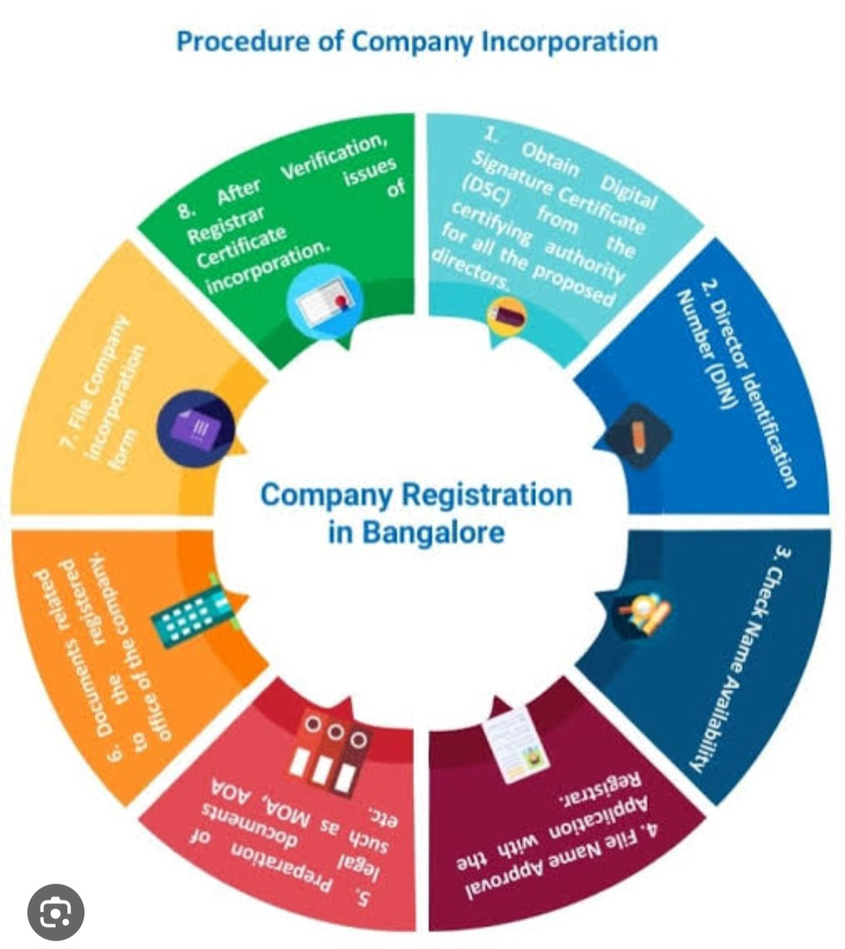

Slide 36
RESULT:
All the above processes are done that training and testing, model evaluation ,prediction ,visualization of prediction ,monitoring and updating are done .This process allows you to explore historical trends and make informed predictions about future company registration based on ROC.

Slide 37
CONCLUSION:
Exploring and predicting company registration trends can lead to better decision-making, resource allocation, and policy formulation, ultimately benefiting businesses and society as a whole. However, it's crucial to approach this task with a rigorous data strategy and a commitment to data quality, security, and ongoing improvement.

